Slide 1
Ayan Guha
Derrik Dennis
Matthew Elenniss
Odill Rodrigues
Sarah Parzyck
HurriPy
A group of world-renowned data scientists took upon themselves to analyze the correlations between cyclones and impacting factors.
Notes:
Title Slide

Slide 2
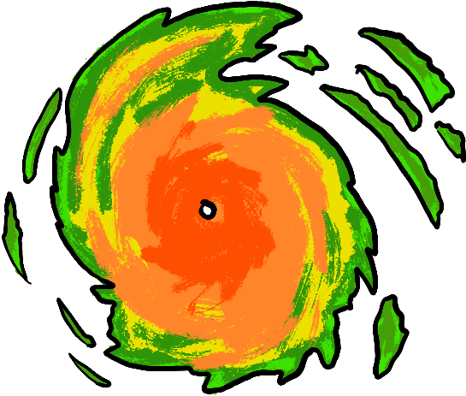
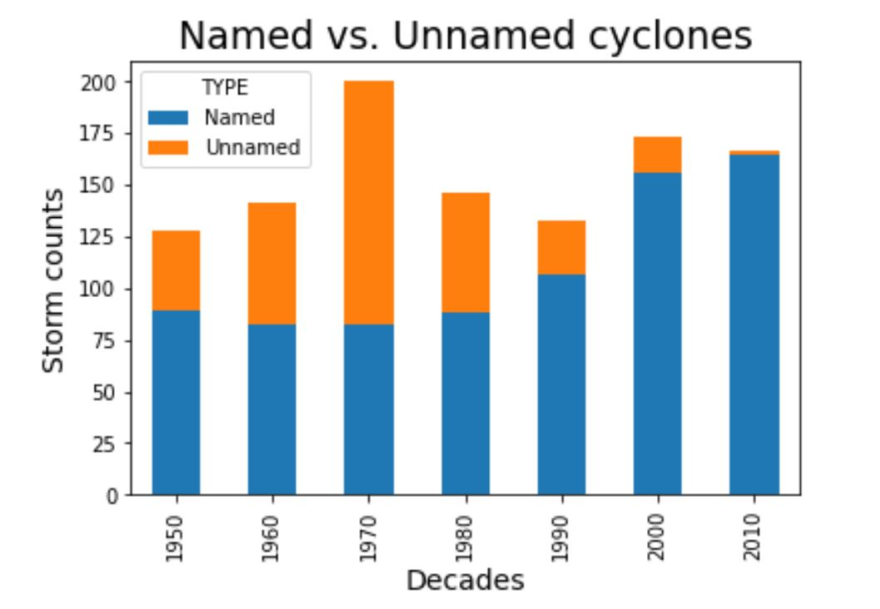
Understanding Cyclones: Names
It wasn’t until recently that most cyclones were named.
In 1970 the amount of cyclones seemed to have effected the number that were named.

Slide 3

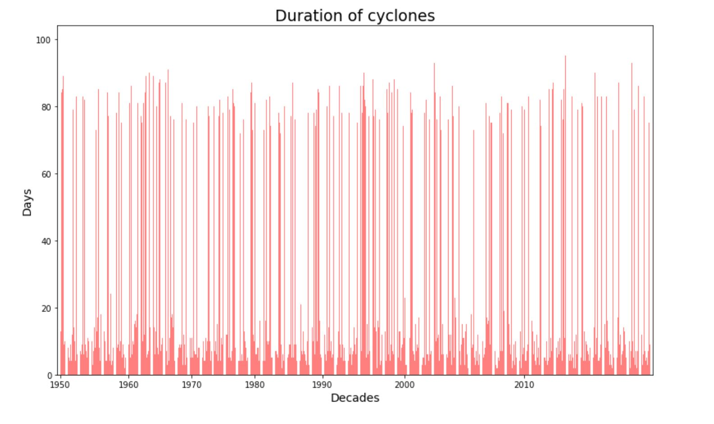
Understanding Cyclones: Duration
Most cyclones last 3-7 days.
Some outliers last 90 days.

Slide 4

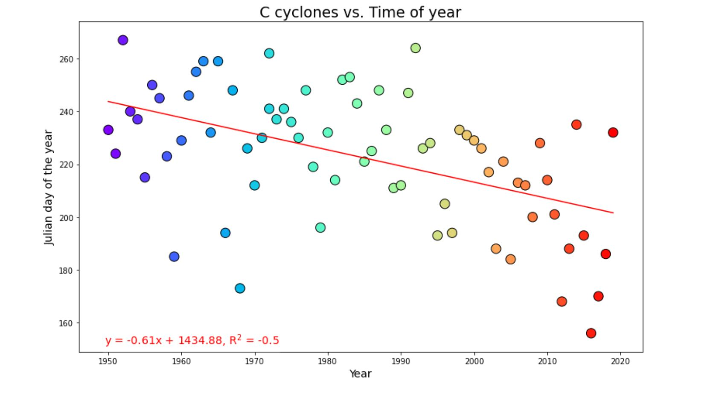
Understanding Cyclones: When do they form?
Cyclones are starting to form earlier in the year.
In 70 years the average season start time has decreased by an entire month.
Hurricanes and Cyclones are caused by warm water temperatures. Our findings have been that due to climate change rising the average ocean. temperature, it plays a direct role in the transition of the season start time.

Slide 5

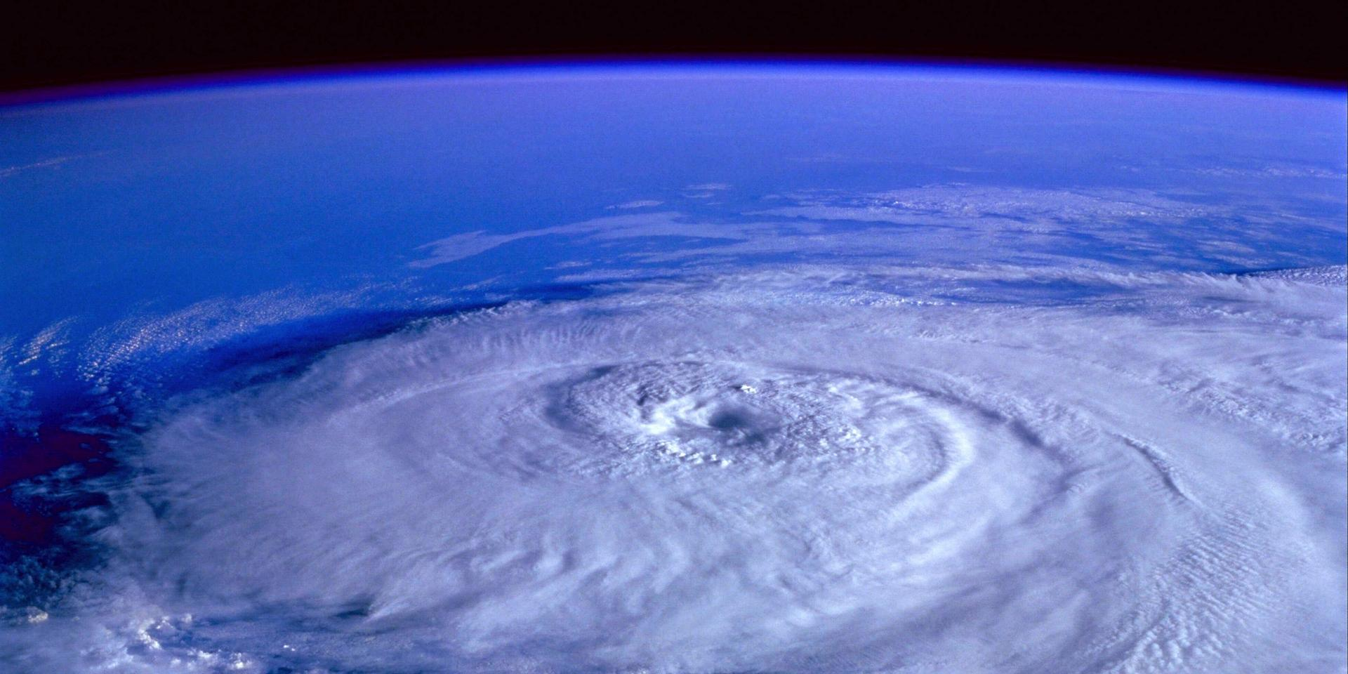
Understanding Cyclones: Conclusion
More Cyclones are getting named.
Most Cyclones last 3-7 days, but the outliers last up to 90.
Cyclones are forming a month earlier on average than 70 years ago.

Slide 6

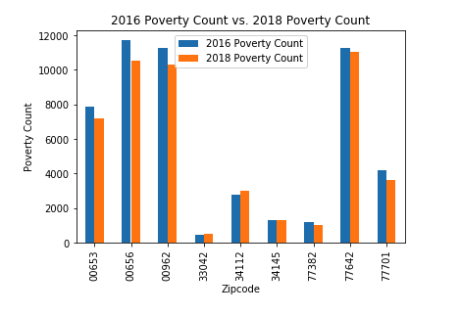
Demographics: Poverty
Results surprised us.
Found that (on average) poverty went down after a major Hurricane.

Slide 7

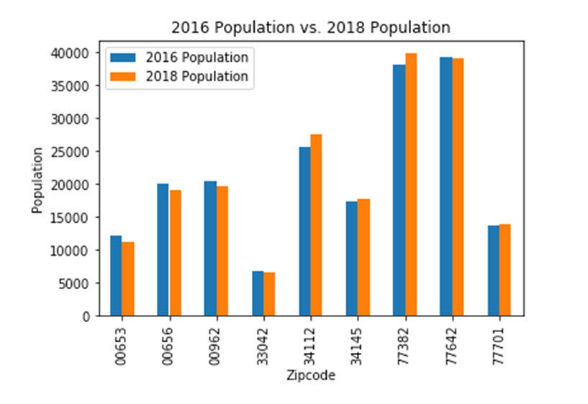
Demographics: Population
These results were also surprising.
After some hurricanes, the population slightly increased, and others it slightly decreased.
Doesn’t seem to be a correlation between hurricanes and effecting population count.

Slide 8

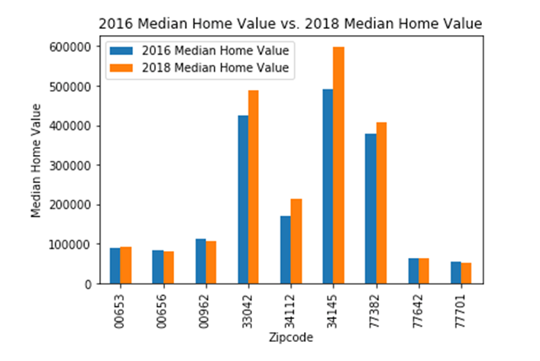
Demographics: Median Home Value
This finding was our most surprising.
Hurricanes have a positive effect on a home value.
The frequency of hurricanes doesn’t effect the home buyers' value on a home.

Slide 9
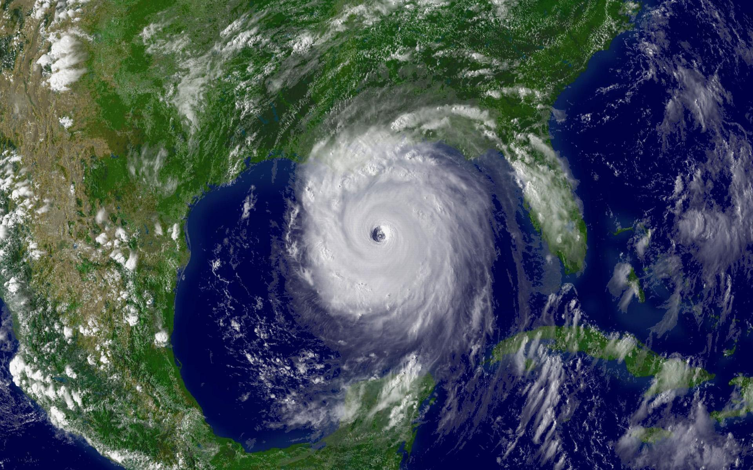
Demographics: Conclusion
Hurricanes reduce poverty in an area.
Hurricanes have no correlation with population changes.
Hurricanes have a positive effect on a home value.

Slide 10
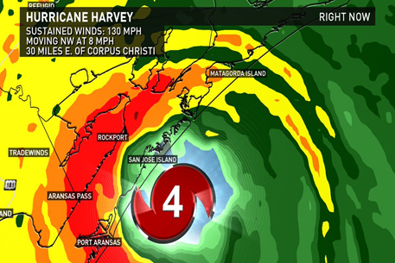
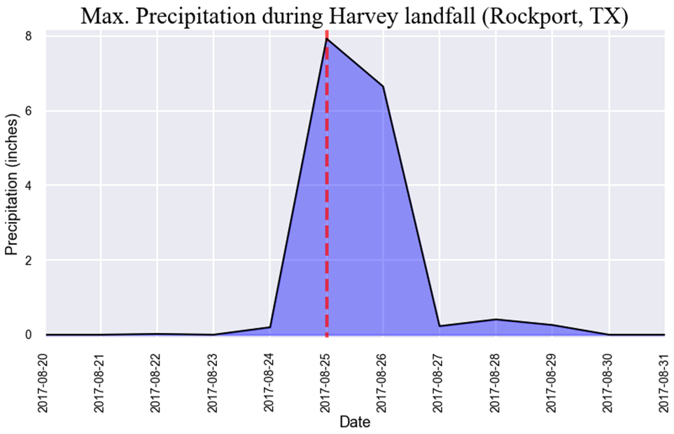
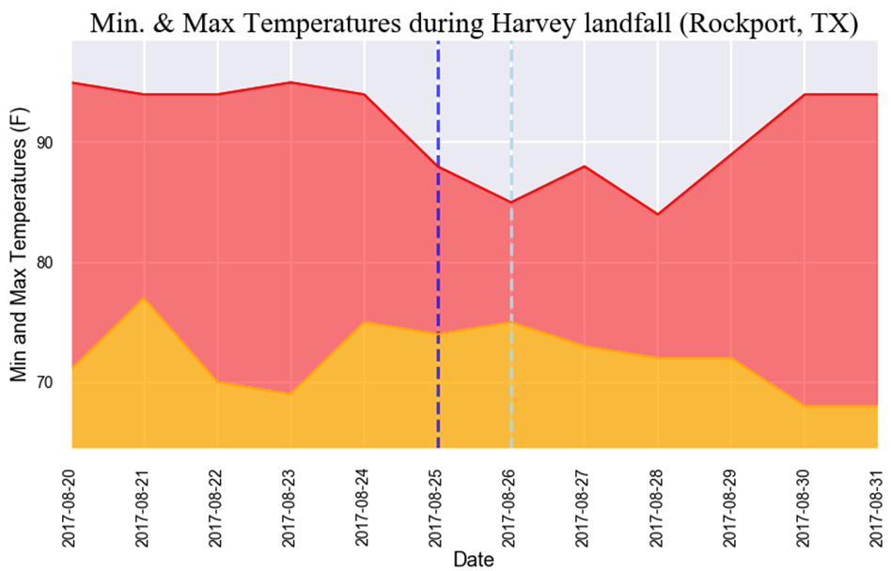
Predictive Data Modeling: Harvey (2017)
The more rainfall the cooler the temperature.
Average water temperature decreased by 4 Celsius after each hurricane.

Slide 11
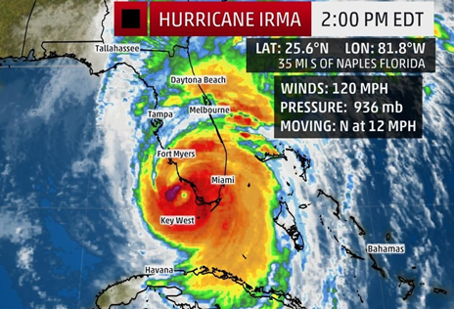
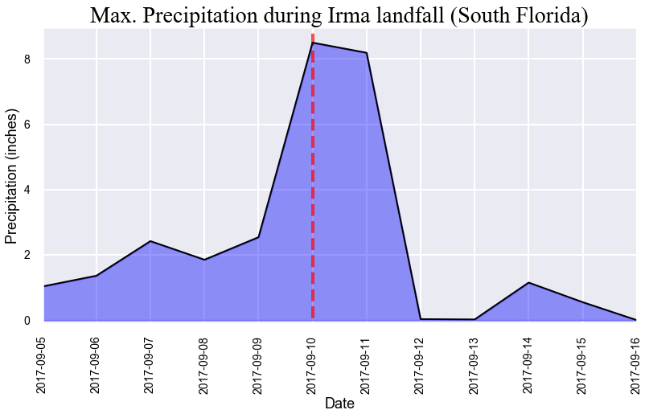
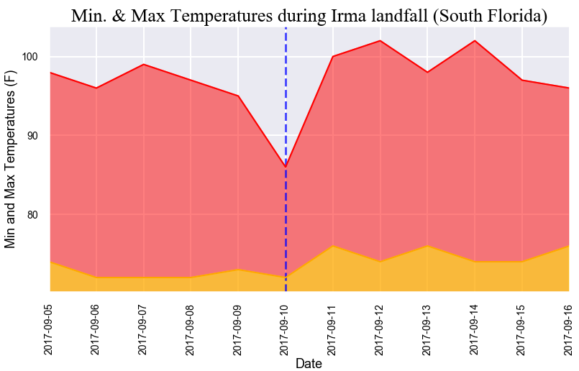
Predictive Data Modeling: Irma (2017)
The more rainfall the cooler the temperature.
Average water temperature decreased by 4 Celsius after each hurricane.

Slide 12
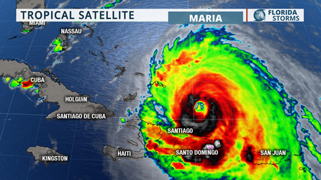
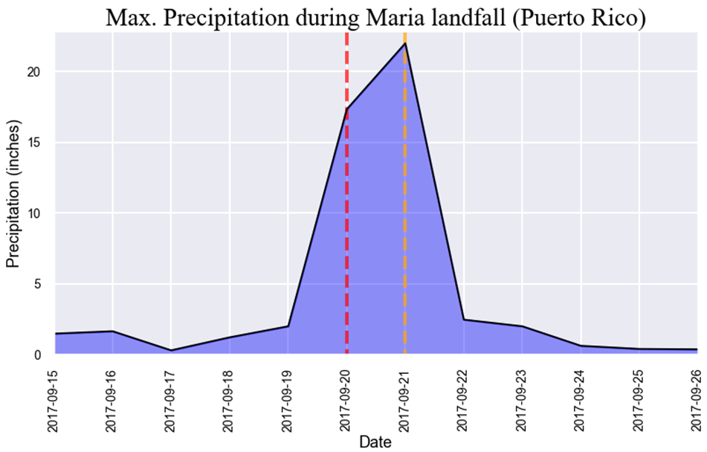
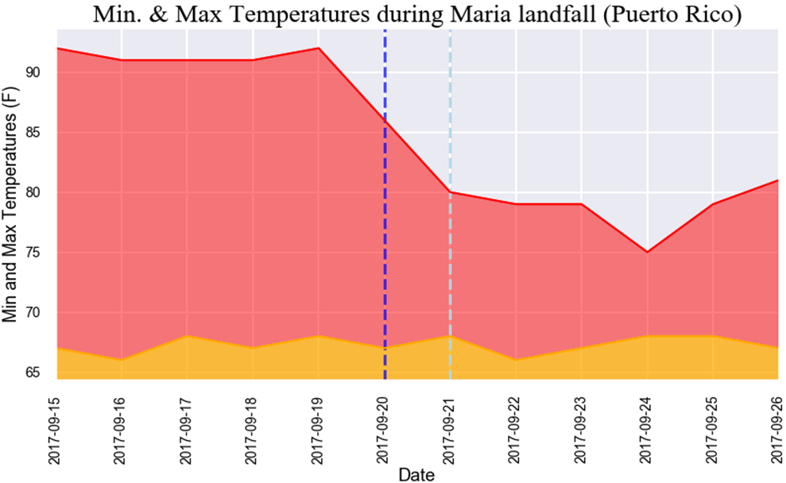
Predictive Data Modeling: Maria (2017)
The more rainfall the cooler the temperature.
Average water temperature decreased by 4 Celsius after each hurricane.

Slide 13



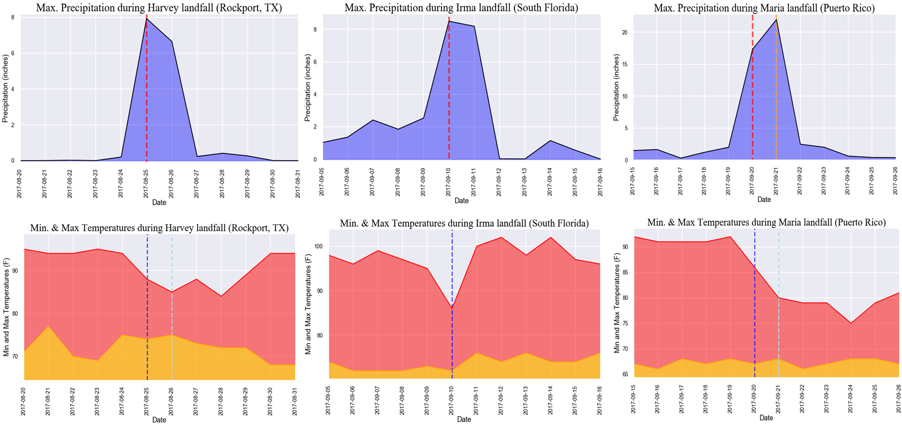

Slide 14
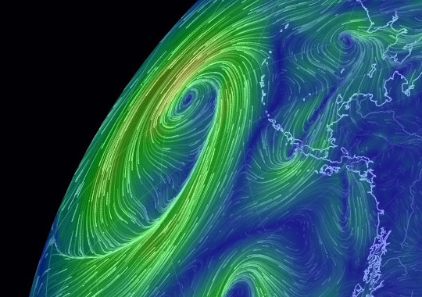
Predictive Data: Conclusion
Our study found that hurricanes have a “cooling effect” on earth.
Mother Nature’s method of managing heat imbalance in oceans is creating hurricanes – a giant blender that mixes the hot air at the center with the dry colder air at the top of the troposphere.

Slide 15

Resources:
Data sets used:
https://www.census.gov/
https://www.ncei.noaa.gov
https://www.nhc.noaa.gov/
https://www.weather.gov/
https://www.usgs.gov
TA:
https://www.census.gov/data/developers/data-sets/business-dynamics.html
API keys requested from:
https://towardsdatascience.com/getting-weather-data-in-3-easy-steps-8dc10cc5c859
https://www.nhc.noaa.gov/data/hurdat/hurdat2-1851-2019-052520.txt
https://www.nhc.noaa.gov/data/hurdat/hurdat2-format-nov2019.pdf

Slide 16

Special thanks to Bob!
ALL HAIL THE KING!

Slide 17
Everything past this slide is just “place holders” and notes for me. None of it (including this slide) will be included in the final project.
Viewer Discretion is Advised.

Slide 18
Who did what?
Understanding cyclones patterns over the past few years (Odille)
Demographics of top 3 costliest cyclone hit areas on the mainland in the past 10 years (Sarah)
Tracking a Storm (Derrik)
Predictive Data Modeling (Ayan)

Slide 19
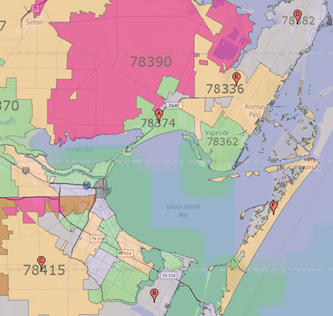
Predictive Data Modeling: Harvey (2017)

Slide 20
The study hopes to provide information regarding:
Understanding the cyclone patterns over the past few years – Data collection (DD), Data cleaning (OR)
The onset of cyclone season as it pertains to the time of the year – Box plot for each decade (AG)
Named vs. unnamed - Stacked bar chart (OR)
When do we usually see named cyclone with the letter “C” – Line graph (OR)
Cyclone by category level and year – Stacked bar chart (OR)
The time it takes to go from a tropical storm to a cyclone – Bar graph with line graph (OR)
Demographics of top 3 costliest cyclone hit areas on the mainland in the past 10 years – Data collection (SP)
Cyclones: Harvey, Irma, and Sandy that all hit in the past decade - Line graph ( )
Have damage costs increased or decreased over the past 10 years - Line graph ( )
Top 3 biggest for a year and their line graph - Line graph ( )
Population: Year before and year after – Line graph for YOY% change ( )
Median home values: Year before and year after – Line graph for YOY% change ( )
Poverty rates: Year before and year after – Line graph for YOY% change ( )
Tracking a storm
The path of Cristobal and top 3 (DD & ME)
Predictive data modeling based on land weather station historical data (AG)
Rough breakdown of tasks:
Agree on methodology
Data sources and collection
Data cleaning
Data visualization
Conclusions and summary

